Slide 1
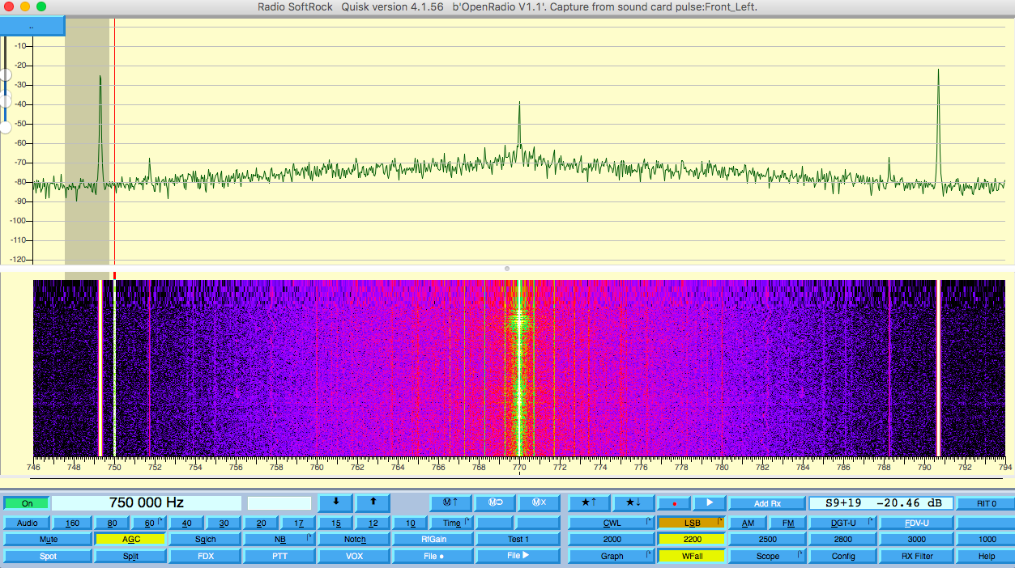
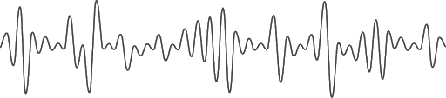
Software Defined Radio Receiver
Joshua Silver & Jordyn Watkins
ENGR 357

Slide 2


Introduction
Qualitative Objectives
Learn how to approach an electronics project
Familiarize with referencing datasheets
Practice troubleshooting
Teamwork Collaboration
Quantitative Objectives: Working SDR Receiver that meets the following specifications
Minimum discernible signal less than 1 uV
Image rejection over 48 kHz of band greater than 30 dB
Tunable range of frequencies greater than 48 kHz
Band frequency greater than 540 kHz
Spurious signals below 10 uV
Within $25 budget
Easy to use (user friendly)
$28 – op amps are expensive fyi

Slide 3
Notes:
Transfrmer, AGND,

Slide 4
Design
Bandpass Filters
Local Oscillator
Tayloe Mixer
Summing Op-amps
& Low Pass Filter

Slide 5
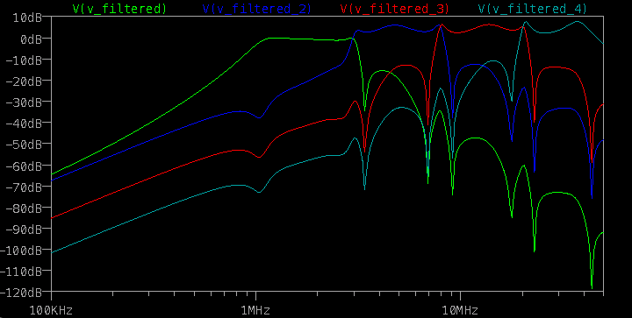
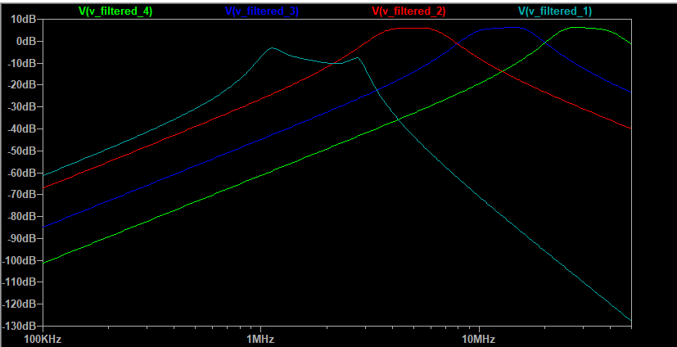
Design – LTSpice Sim

Slide 6
Design
Bandpass Filters
Local Oscillator
Tayloe Mixer
Summing Op-amps
& Low Pass Filter

Slide 7
Design
Bandpass Filters
Local Oscillator
Tayloe Mixer
Summing Op-amps
& Low Pass Filter

Slide 8
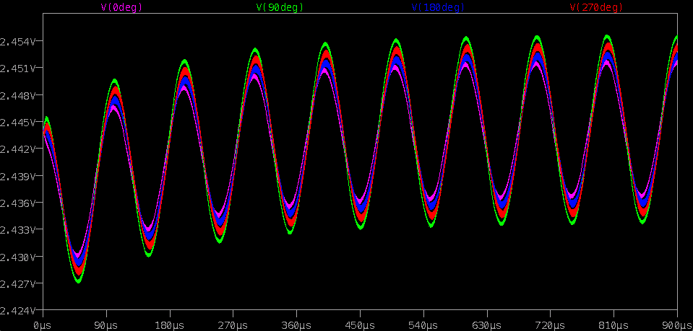
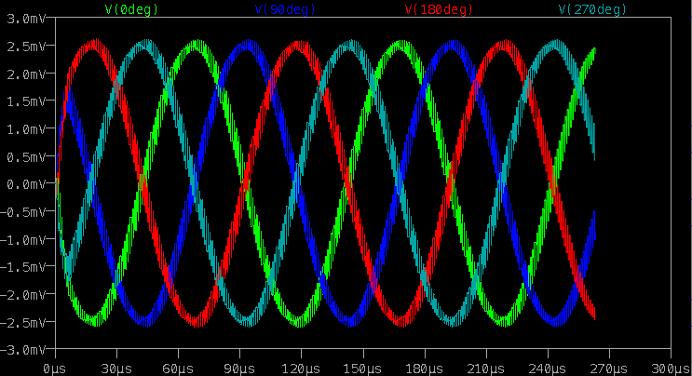
Design – LTSpice Sim

Slide 9
Design
Bandpass Filters
Local Oscillator
Tayloe Mixer
Summing Op-amps
& Low Pass Filter

Slide 10
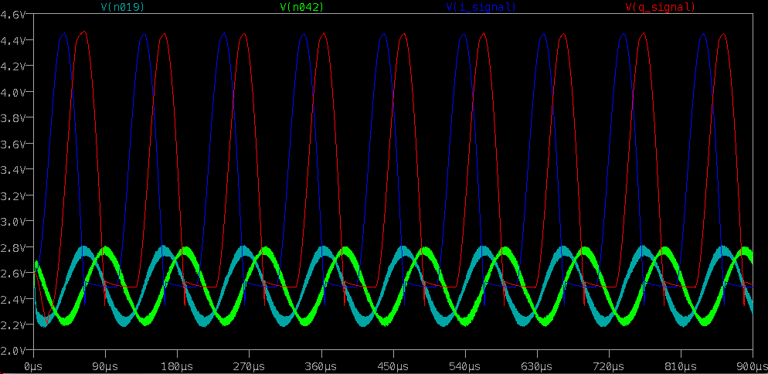
Design – LTSpice Sim

Slide 11
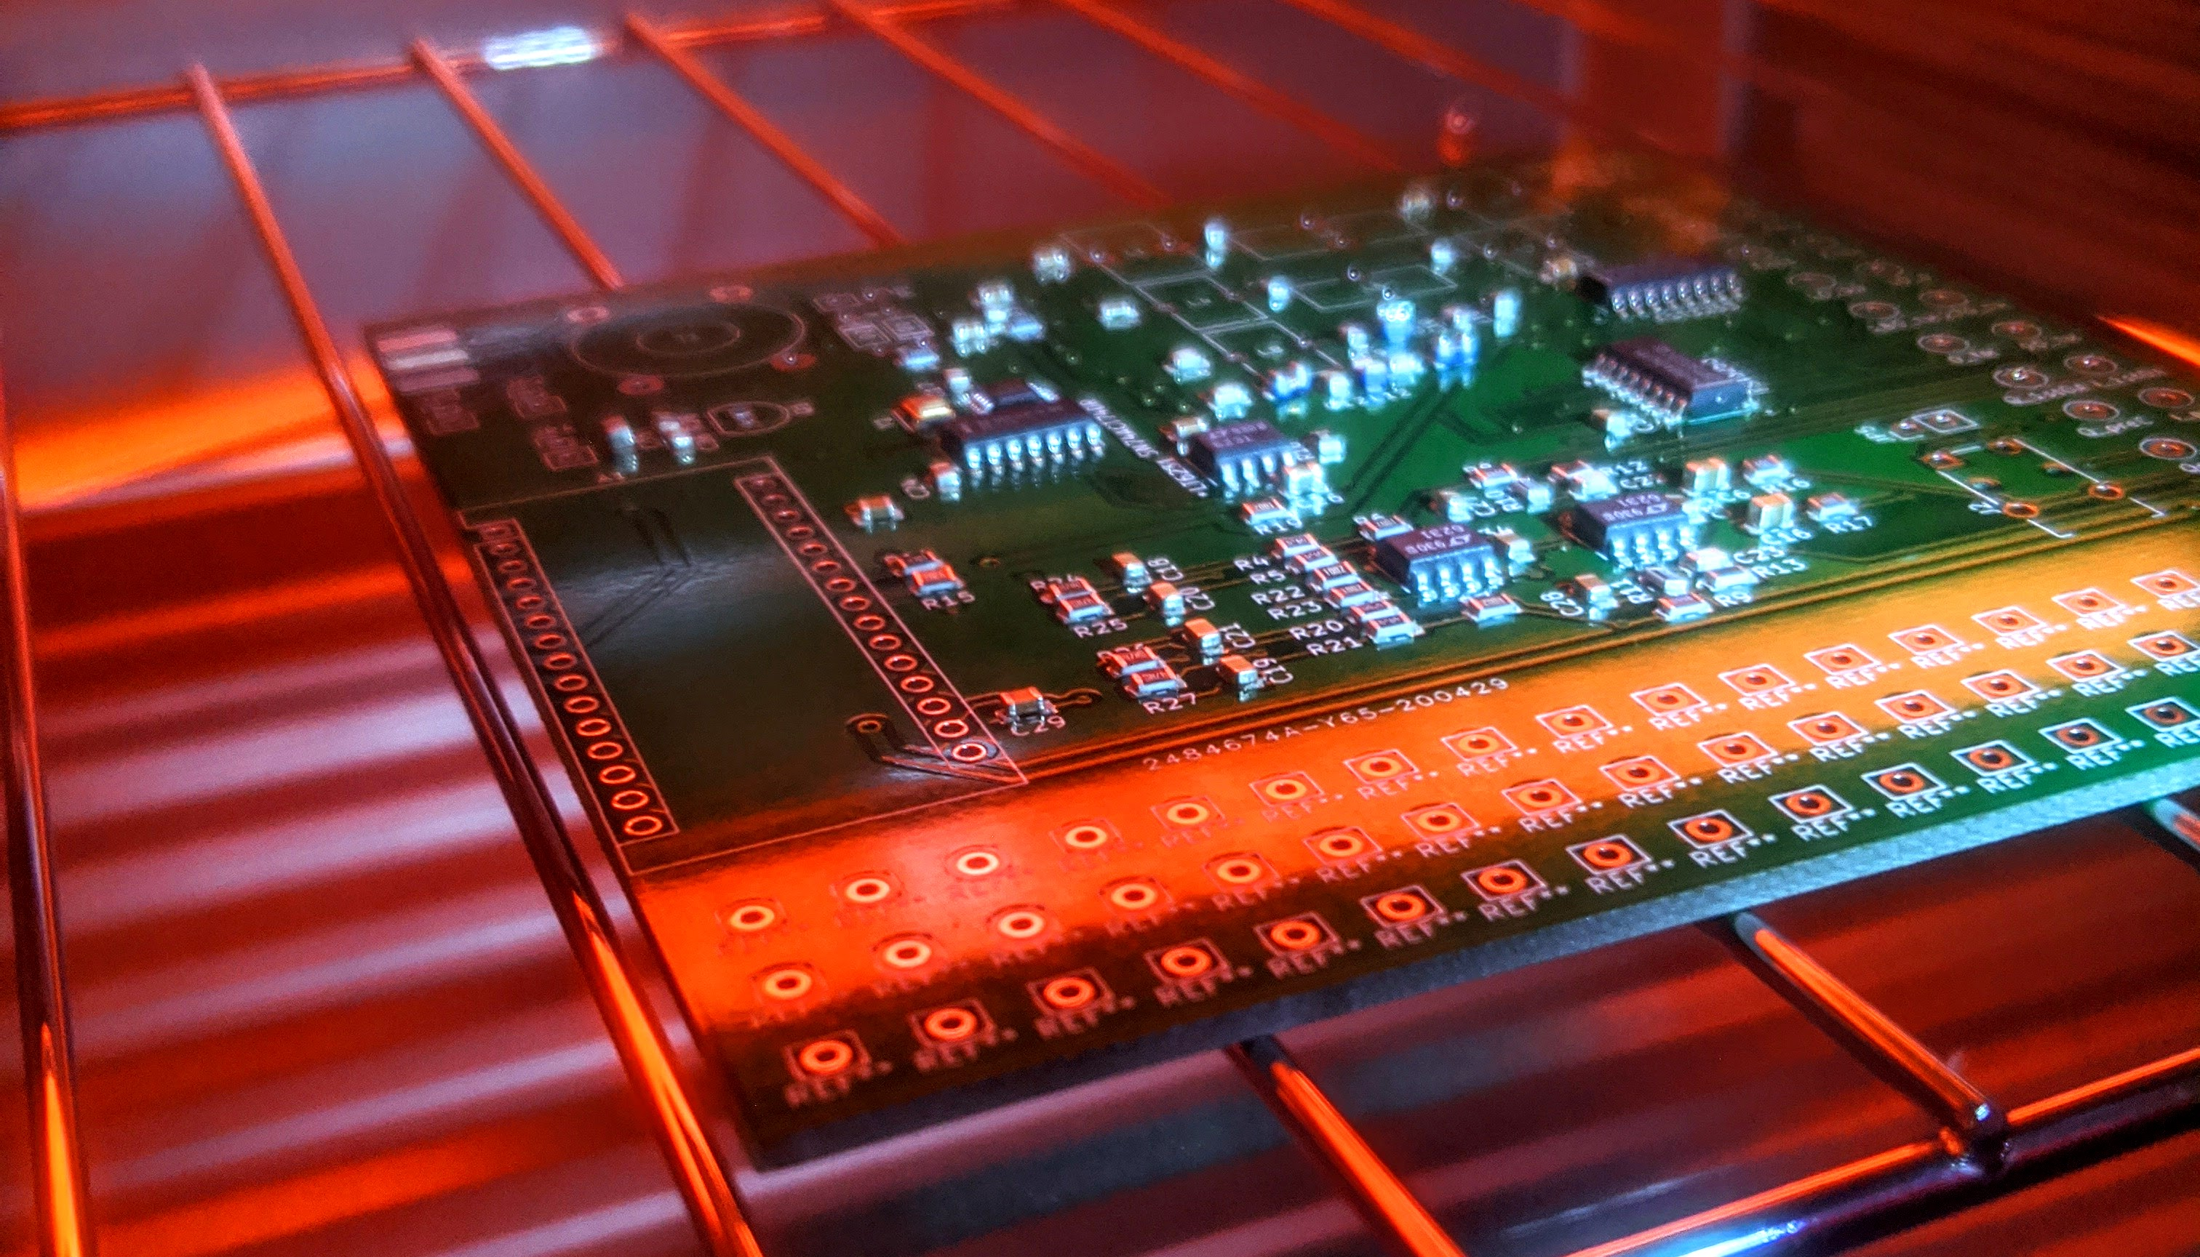
Build
SMD Components
Stencil Use
Toaster Oven as Reflow Oven
Inductor and Transformer Windings

Slide 12
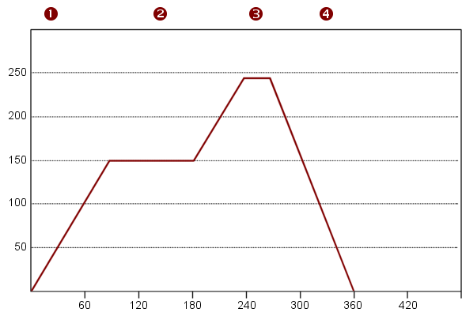
Build
SMD Components
Stencil Use
Toaster Oven as Reflow Oven
Inductor and Transformer Windings
Through hole components

Slide 13
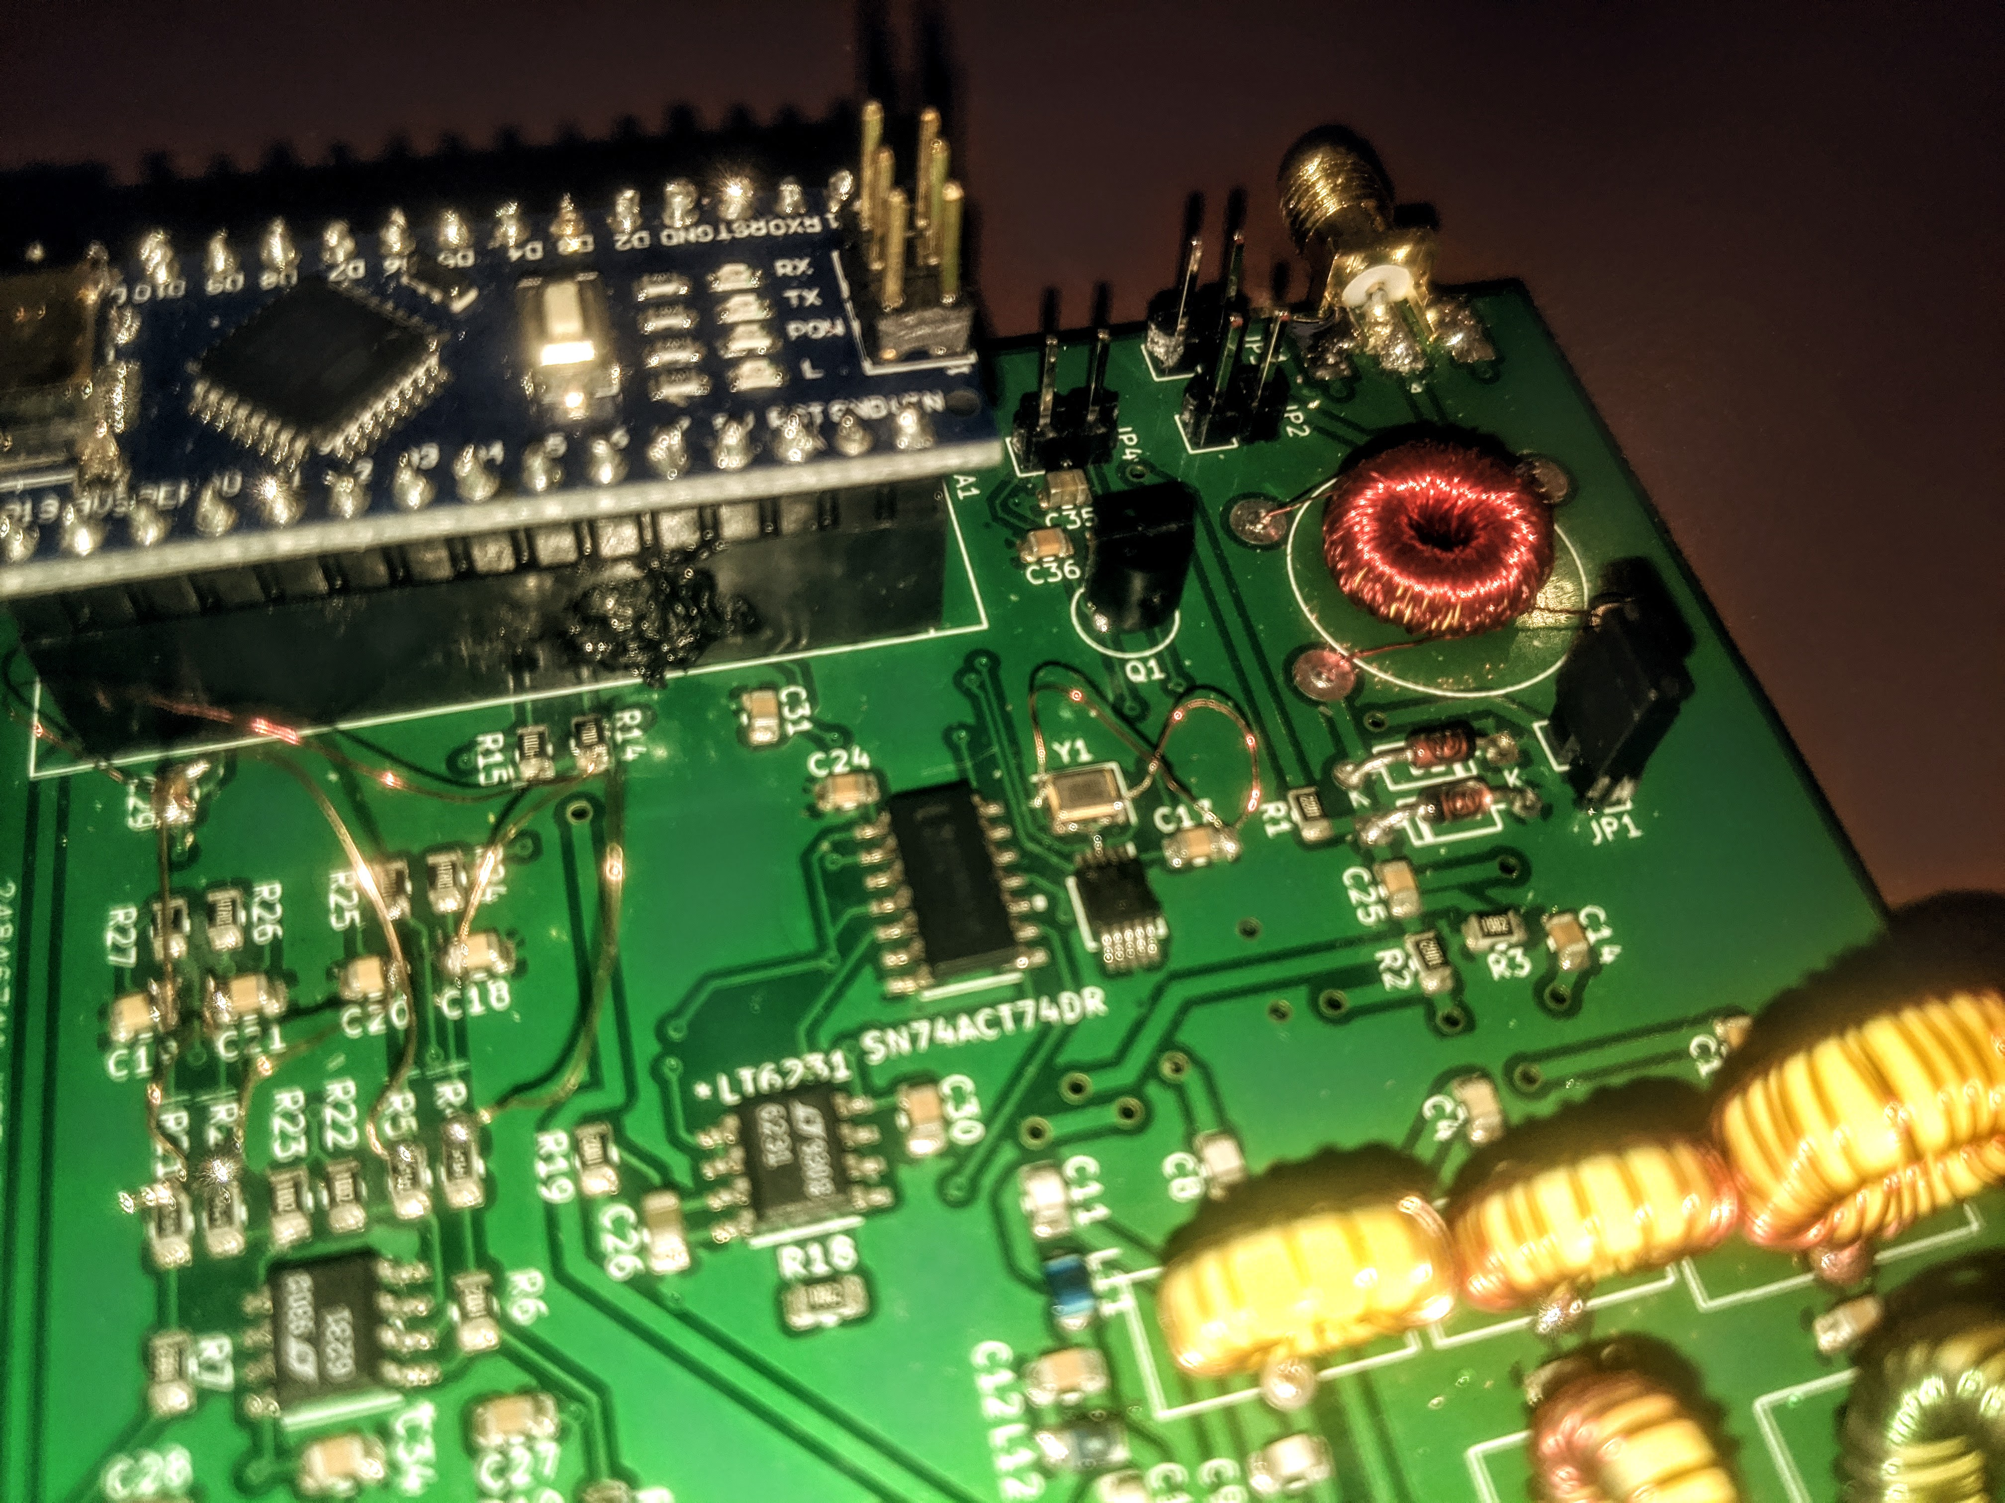
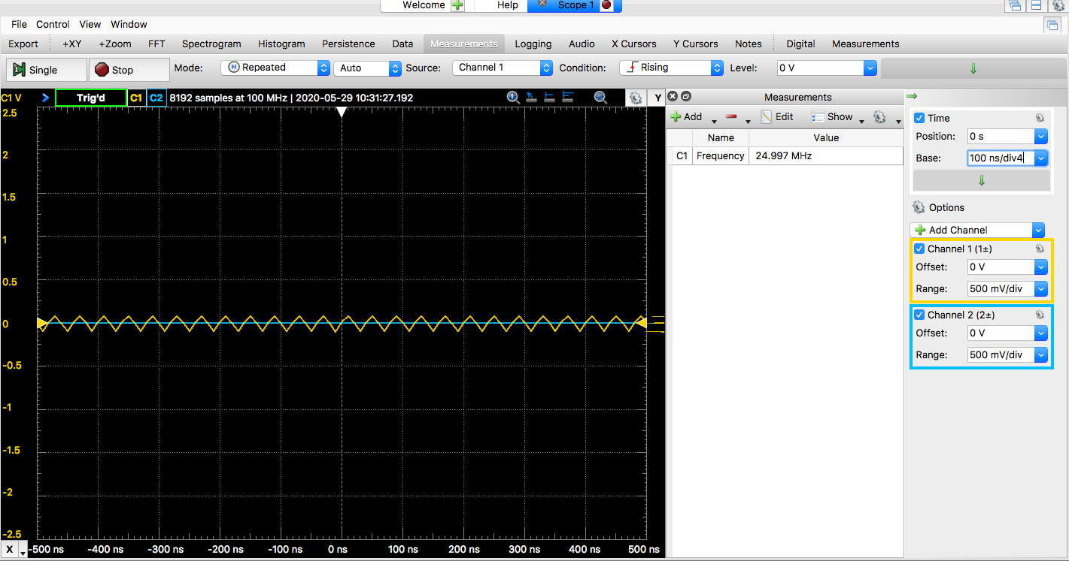
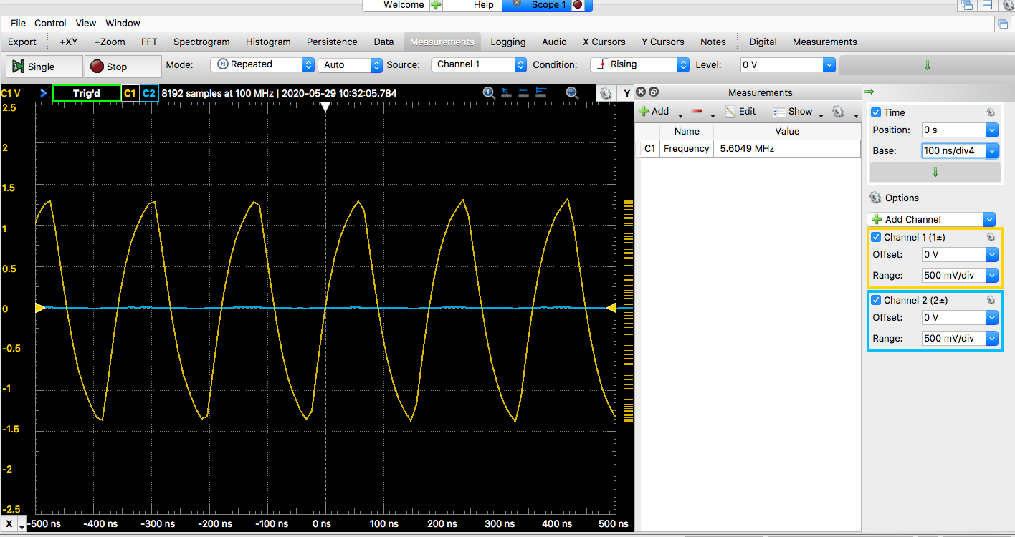
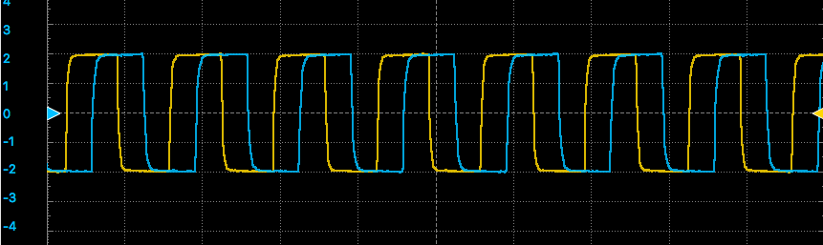
Testing
Local Oscillator
Crystal
Si5351
Johnson Counter
Bandpass Filters
Bandpass Filter Selection
Clarity of signal coming through
Tayloe Mixer
Mirrors simulation?
Loading effects
I and Q signals
90 degrees out of phase
Healthy Amplitude
Quisk
Notes:
Before we received our components and boards, we were tasked with constructing a build and test plan. While the outline we created was useful - I found that the order of testing varied slightly and the types of errors I found in our board were not ones that I had anticipated.
I started testing the board beginning with the local oscillator, which entailed downloading the necessary libraries and test code for arduino. I found 2 major errors in our design regarding the local oscillator. One, the pad numbers of our crystal were incorrect, and two, our pull-up resistors for the si5351 clock generator were incorrect. The pictures here show the corrected outputs starting with the crystal output of 25Mhz on top, followed by the output of the si5351, and finally the output of the johnson counter below.
This next picture shows the corrections I had to make to our board, circled in red, to get the desired outputs shown previously.

Slide 14
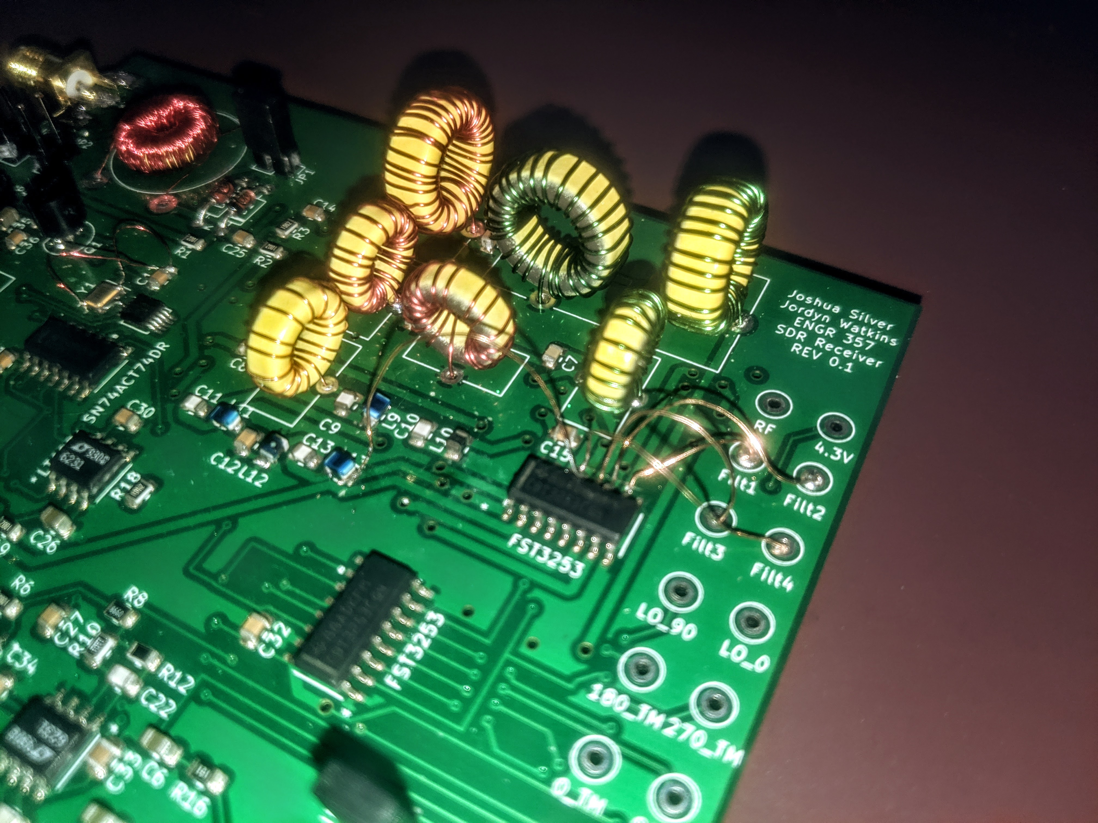
Testing
Local Oscillator
Crystal
Si5351
Johnson Counter
Bandpass Filters
Bandpass Filter Selection
Clarity of signal coming through
Tayloe Mixer
Mirrors simulation?
Loading effects
I and Q signals
90 degrees out of phase
Healthy Amplitude
Quisk
Notes:
The next major component to test was the bandpass filters. Since we had more than one bandpass filter, we had the added task of needing to communicate to the multiplexer which filter to select. For the purpose of testing, I chose to just use the default of 00 to select the first bandpass filter - and in sake of saving time, I decided that editing the actual code for use with quisk for selecting a bandpass filter could be investigated and dealt with at a later time since we already had one bandpass filter working.
The first obvious issue I found with the bandpass filters is that it fried my arduino's 5V usb passthrough. After investigation, we discovered that the wiring for our bandpass filters was incorrect. You can see the correction I made on the board in the picture here.
With this correction, the first bandpass filter appears to be working as expected - though further tests analyzing the selectivity of the filters could be something we could look into in the future.

Slide 15
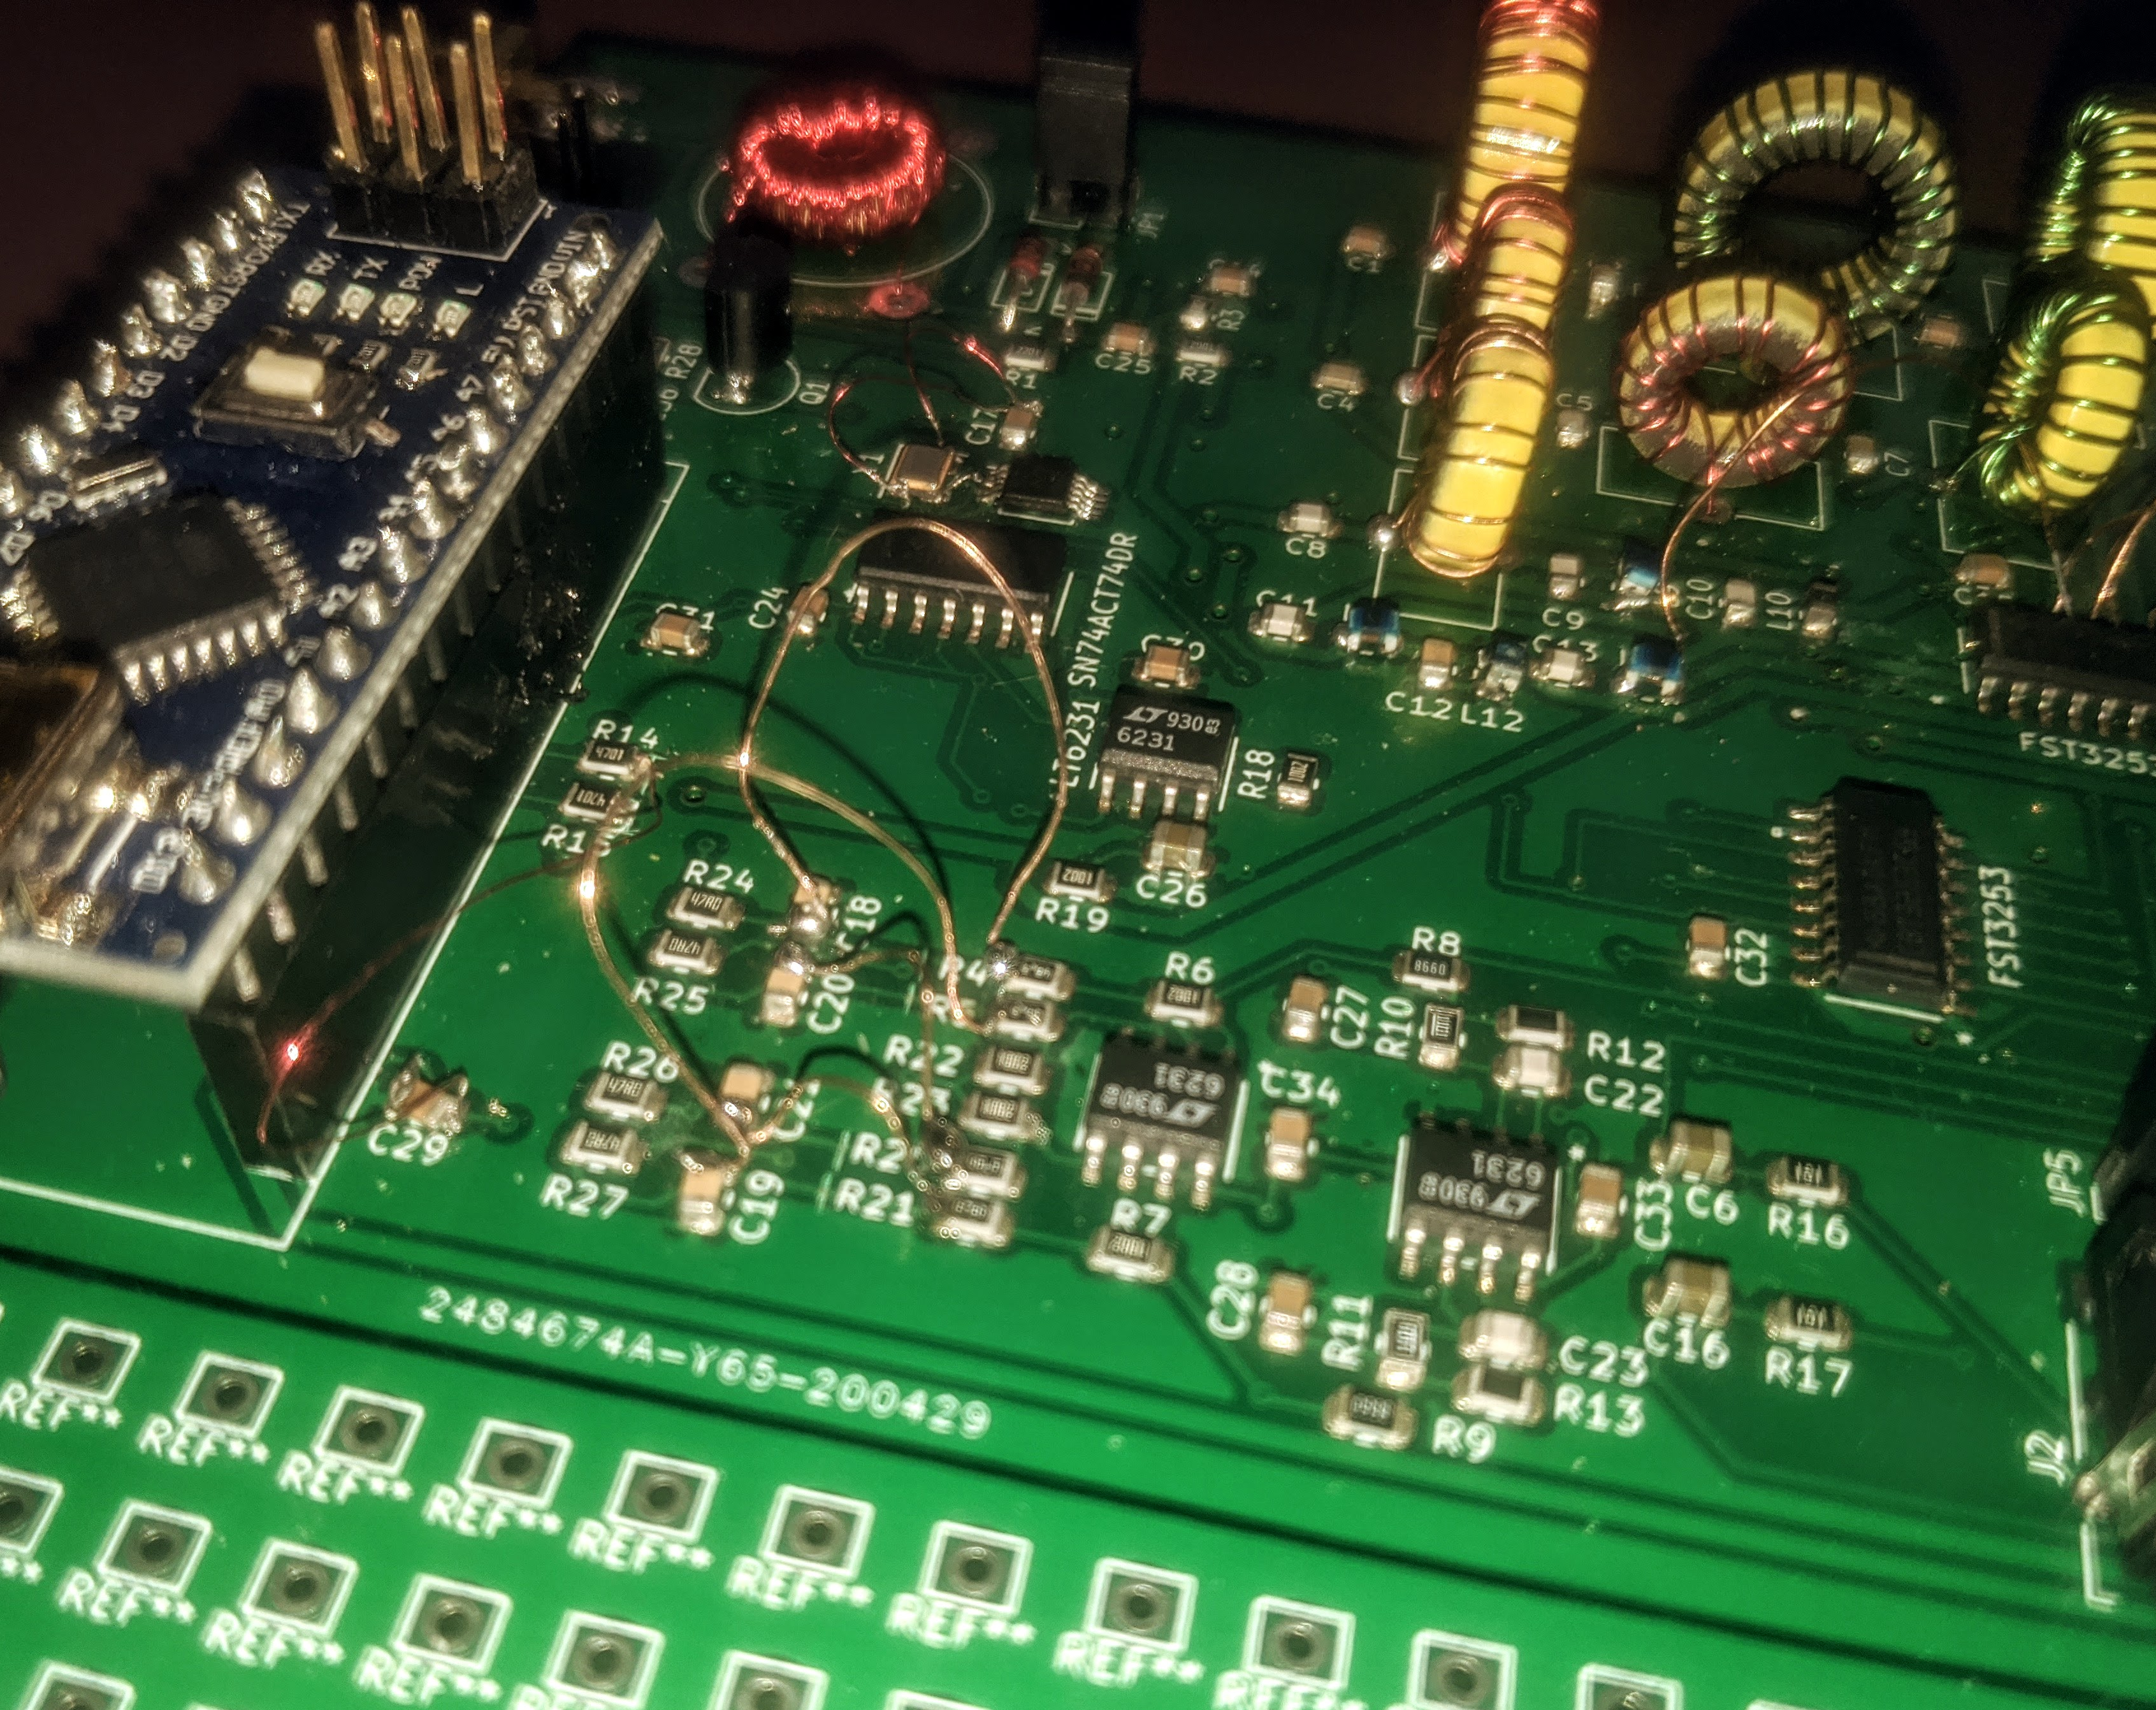
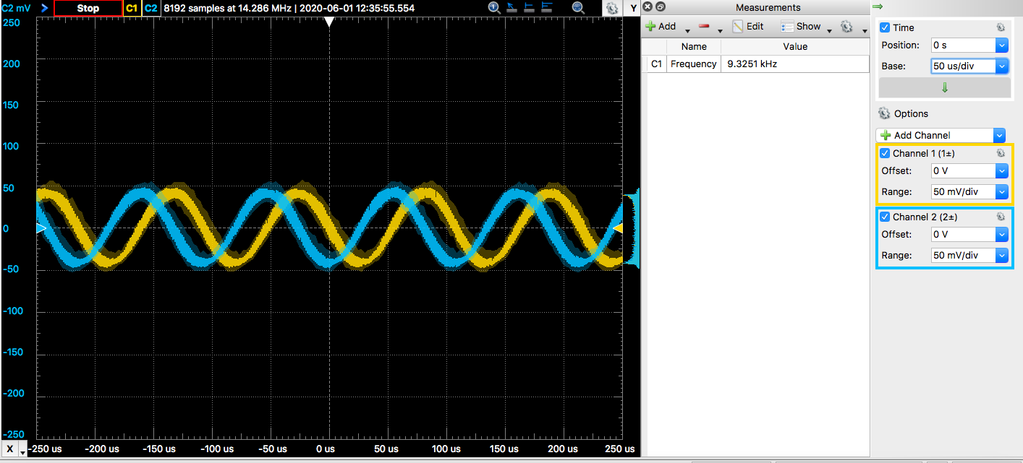
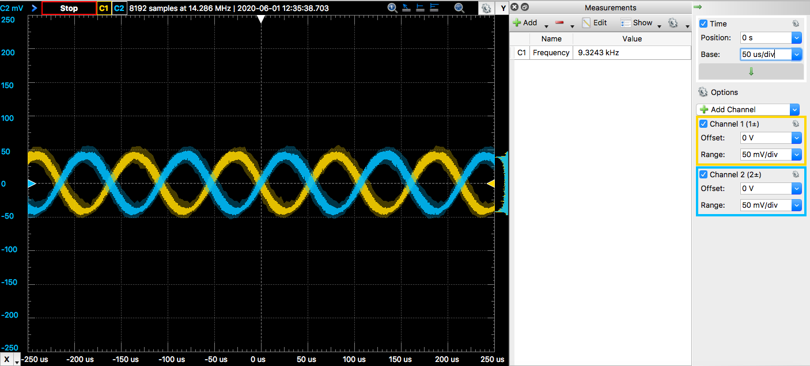
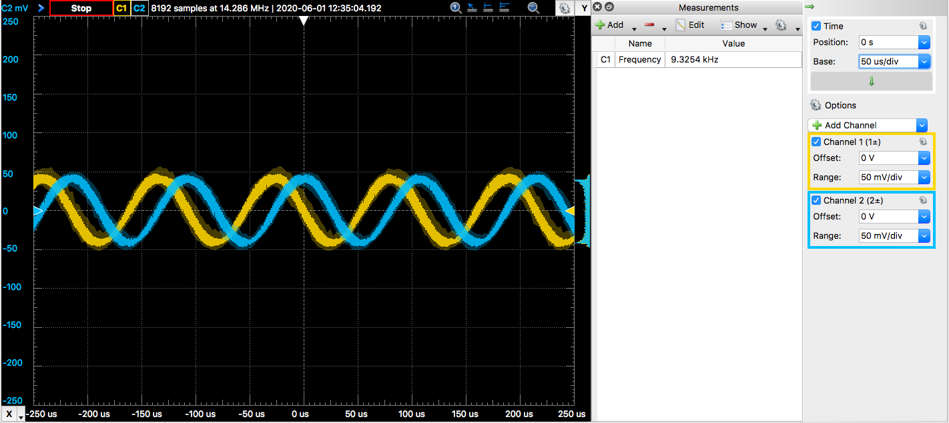
Testing
Local Oscillator
Crystal
Si5351
Johnson Counter
Bandpass Filters
Bandpass Filter Selection
Clarity of signal coming through
Tayloe Mixer
Mirrors simulation?
Loading effects
I and Q signals
90 degrees out of phase
Healthy Amplitude
Quisk
Notes:
Now that we had our RF signal from the bandpass filters sorted out as well as the signal from the local oscillator, I could look into the tayloe mixer. The images you see here are the outputs of the tayloe mixer, where the 0_deg signal is always in yellow. It's important to note that these outputs only look like this when the op-amps are not attached.
Again, we found another issue with this component. Shown in the picture here is the correction made. We had accidentally designed the schematic with the 0 and 90 degree signals being summed, and the 180 and 270 signals being summed. Rather than summing the 0 and 180 together, and the 90 and 270 together. This resulted in a final I and Q signal exactly 180 degrees out of phase instead of 90. Making this correction solved the issue.

Slide 16
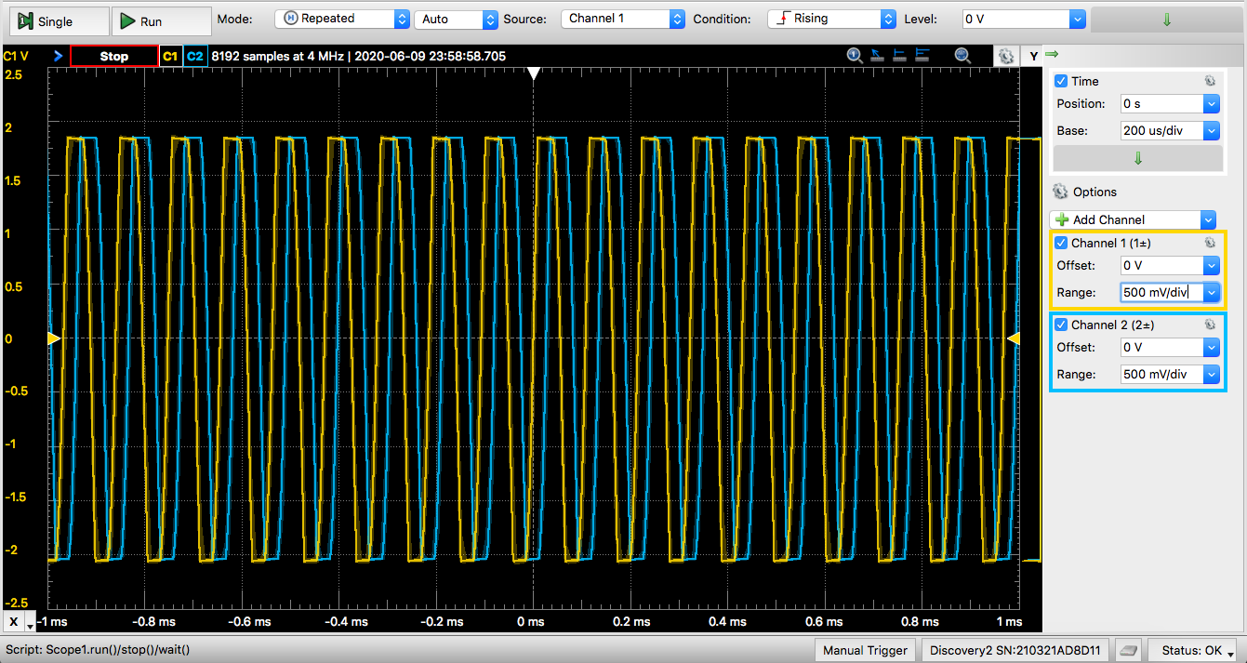
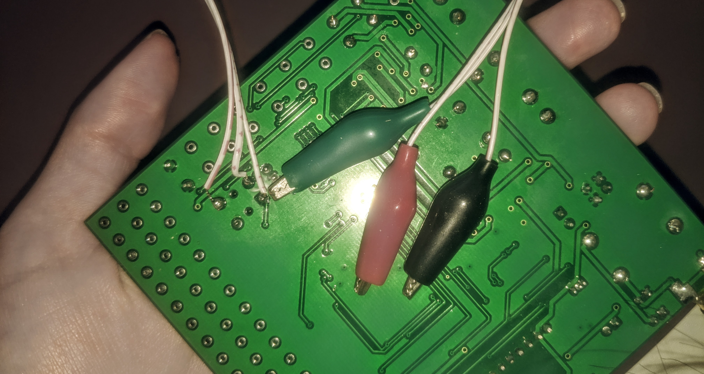
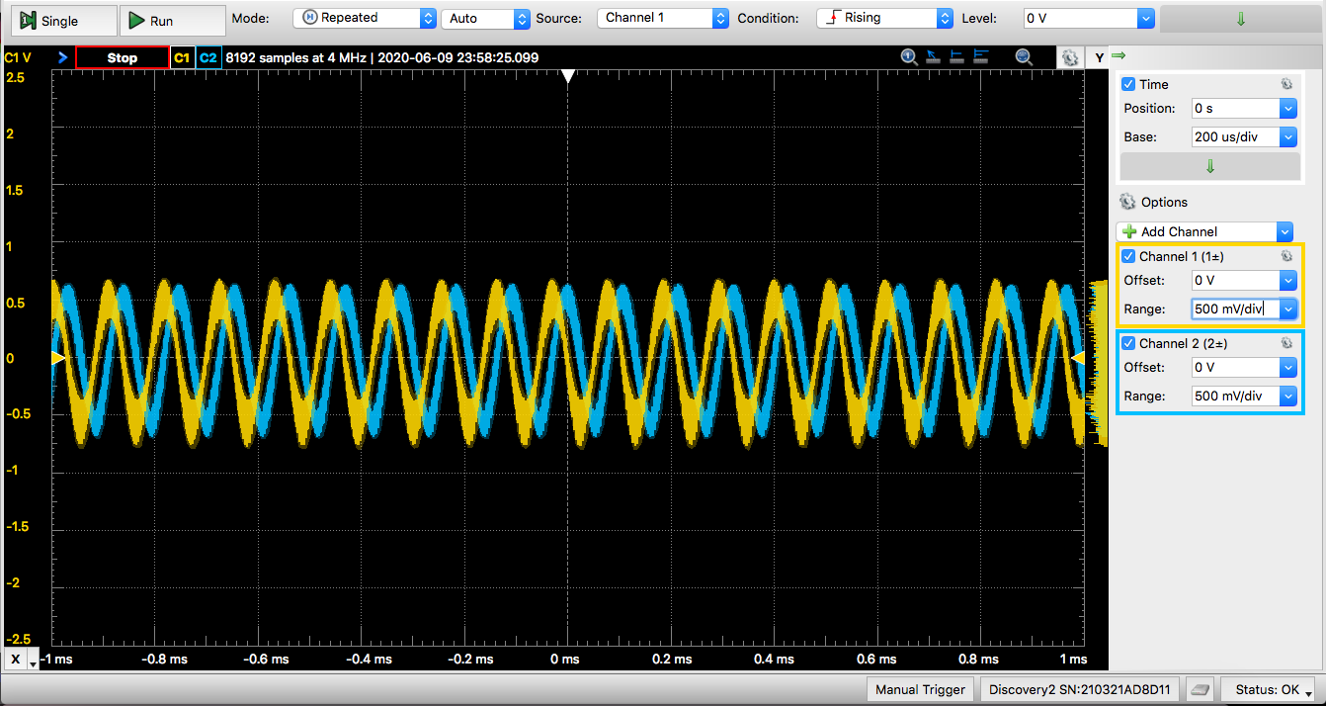
Testing
Local Oscillator
Crystal
Si5351
Johnson Counter
Bandpass Filters
Bandpass Filter Selection
Clarity of signal coming through
Tayloe Mixer
Mirrors simulation?
Loading effects
I and Q signals
90 degrees out of phase
Healthy Amplitude
Quisk
Notes:
This is the output directly after the summing op-amps - 90 degrees out of phase and with the same amplitude. The only issue was that it was still noisy. But that's why we had the second set of op-amps as a low pass filter. You can see that the signal here is much cleaner. Here, I had the input signal a bit too large, hence you can see the clipping here. But this is something we could easily fix with using a smaller input signal from the analog discovery.
Knowing our luck, of course we had to have another issue. You'll note that our signal is 90 degrees out of phase here at the output. HOWEVER, when attached to the audio jack, they became IN phase - therefore we would not see any image rejection. The reason for this was bad connections in the audio jack. You can see in this picture how we side-stepped this issue. The alligator clips were then clipped on to their corresponding R, T, or S section of the cable.

Slide 17
Testing
Local Oscillator
Crystal
Si5351
Johnson Counter
Bandpass Filters
Bandpass Filter Selection
Clarity of signal coming through
Tayloe Mixer
Mirrors simulation?
Loading effects
I and Q signals
90 degrees out of phase
Healthy Amplitude
Quisk
Notes:
A thought before tackling the last major issue. I would reccomend avoiding installing quisk on a mac unless absolutely necessary. It's not exactly an easy step by step process as is described for linux and windows operating system.
Back to the last major issue remaining: quisk was still not rejecting the image. Initially thought to be a mac-quisk compatability issue, we discovered that it was actually a problem with the soundcards being only mono instead of stereo. Switching out the soundcard and some other technicalities regarding the soundcard resulted in the following results...

Slide 18
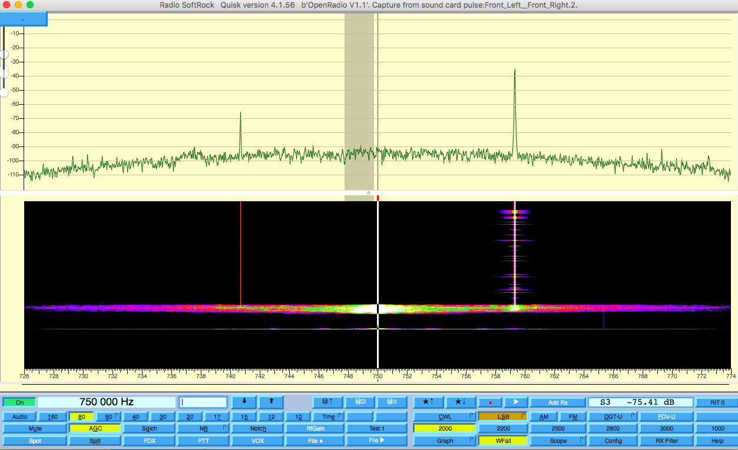
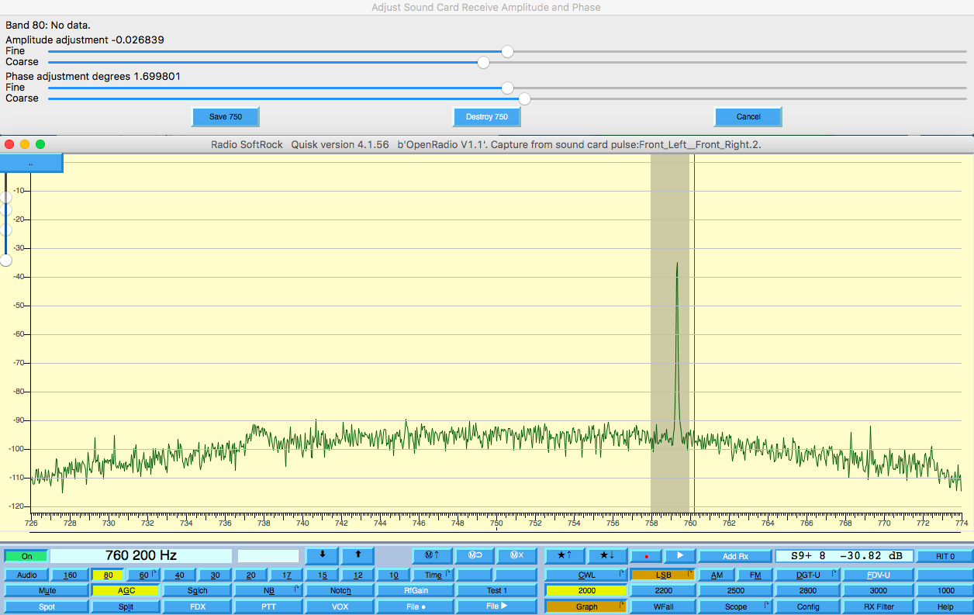
Results
Notes:
Here, I am showing you the fruits of our labor. Image rejection is a little more than 30dB, probably somewhere around 34dB. However, using quisk's RX Phase configuration option, we can pretty much remove the image entirely so that we only have our ONE desired delta function.
I also tested for minimum signal discernability, which came to be around 0.5uV.
This next slide is a short video of the signals I was able to pick up with the receiver using a 2 ft antenna.

Slide 19
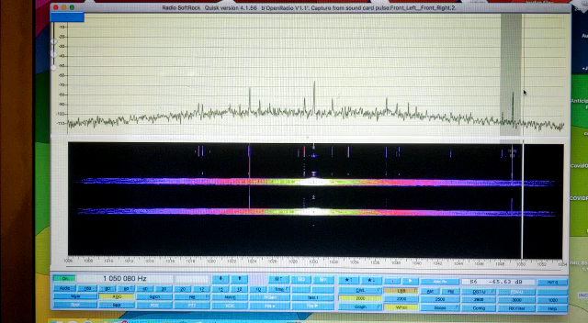
Results

Slide 20
Conclusion
Future Work
Coding for bandpass filter selection through quisk / new arduino code
Test receiver with AM radio frequencies (install very long wire on top of roof)
Discover more bugs
Fix bugs
Make enhancements
Repeat steps 4, 5, and 6
What we learned
Datasheets are invaluable resources
Importance of bring-up procedures
How to approach a problem statement from an engineering perspective
Patience and Perseverance
Notes:
In conclusion here, we essentially have an operating radio receiver! However, there are several things that can be done to make the project more complete. Firstly, getting the rest of the bandpass filters working is probably the first task that needs to be accomplished. Secondly, performing more tests using the receiver to listen for AM radio frequencies, then as we continue to document the project - I'm sure we will continue to find more bugs, proceed to fix them and find inspiration to make enhancements only to find out that the enhancements had bugs and then we'll have to repeat the process.
Probably the most important part of this project: what did we learn. We learned that datasheets are invaluable resources, and learning how to interpret, understand, and apply them are life skills. Secondly, bring-up procedures are very important to follow in order to avoid as many mistakes as possible. We also learned how to approach a problem from an engineering perspective, as well as developed patience and perseverance - especially in the sight of frustration of so many issues needing to be solved.

Slide 21
Questions
Notes:
That brings us to the end of our presentation. Are there any questions?

